Slide 1
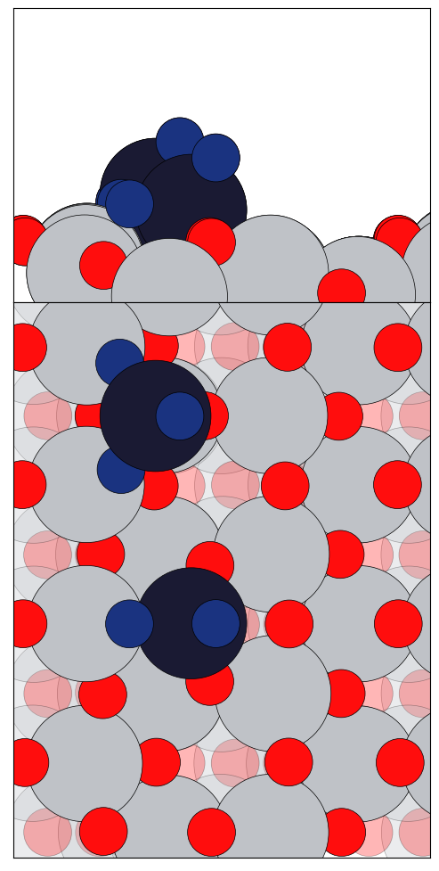
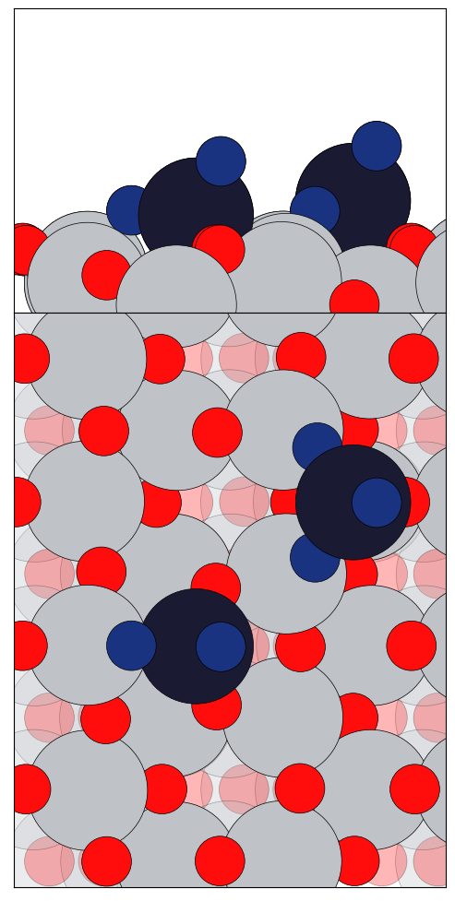
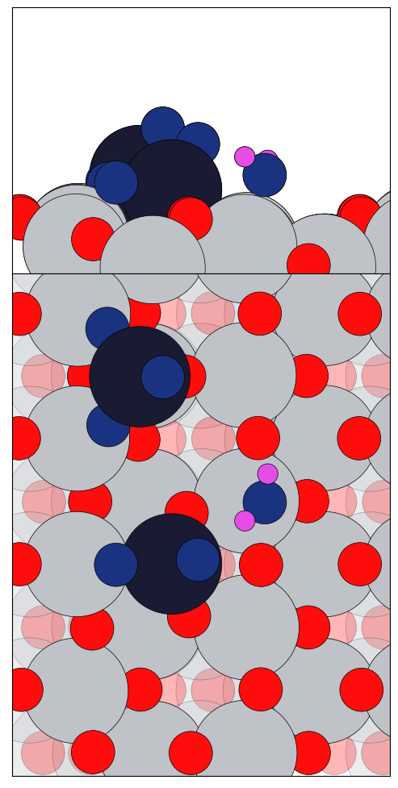
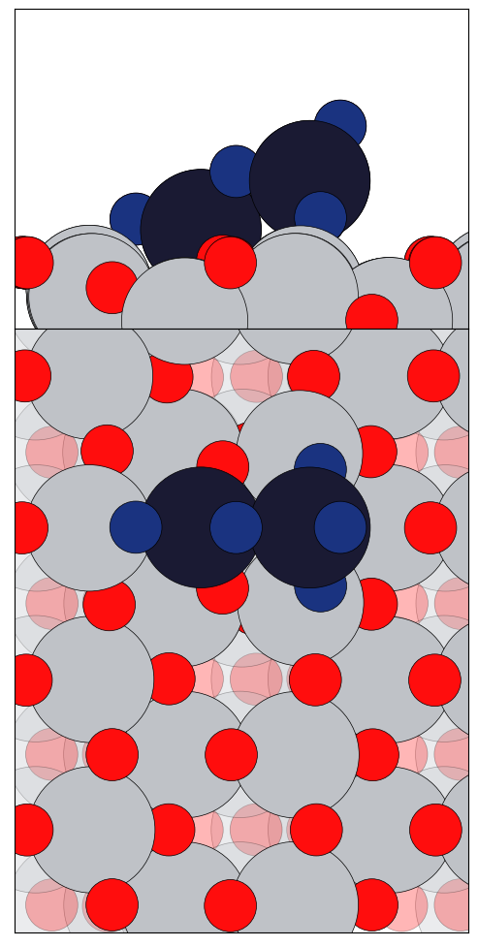
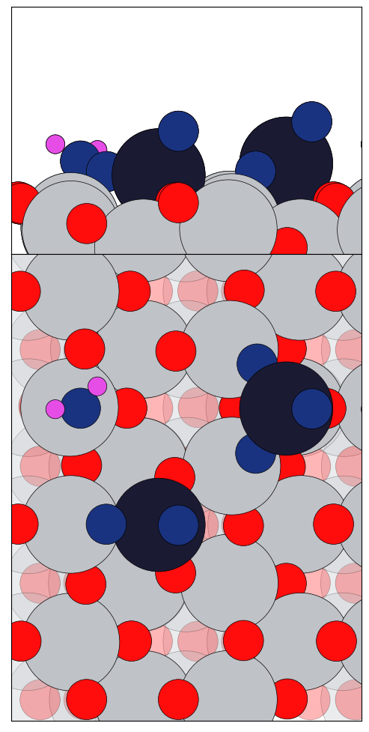
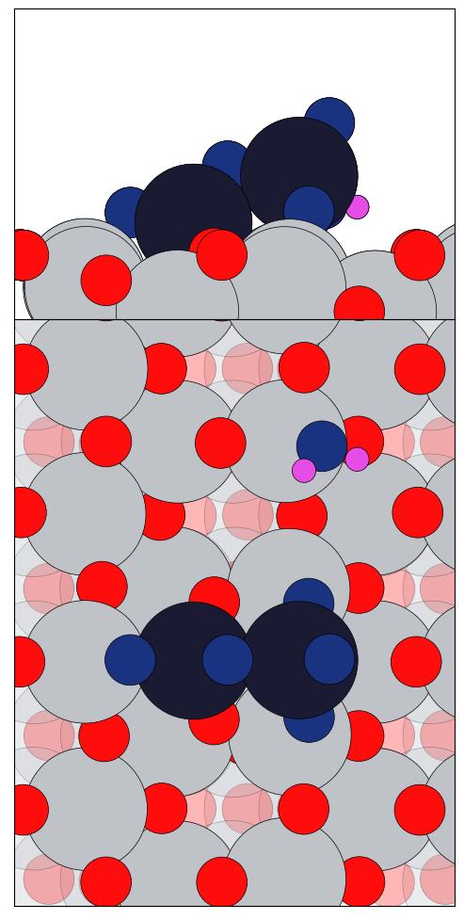
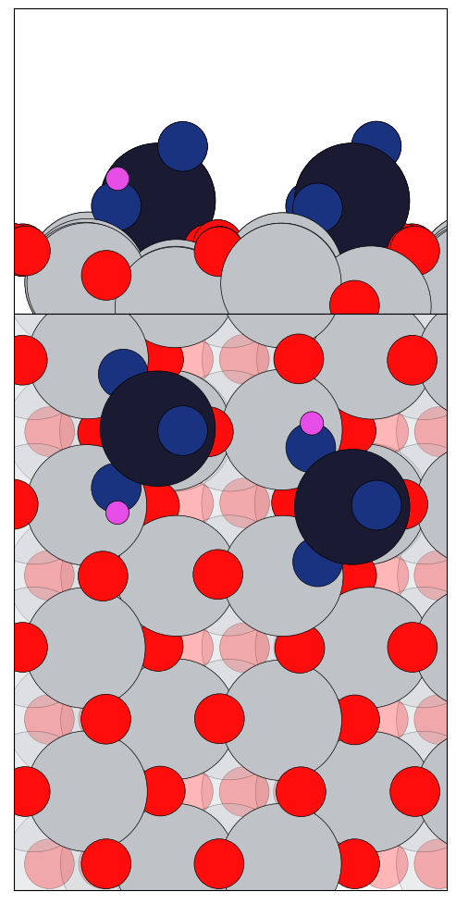
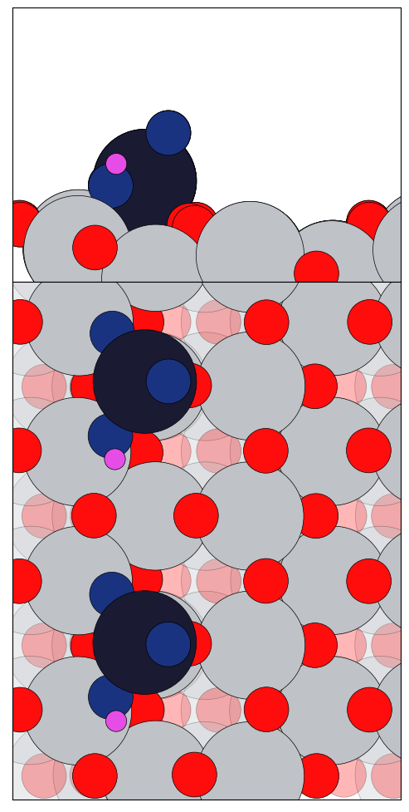
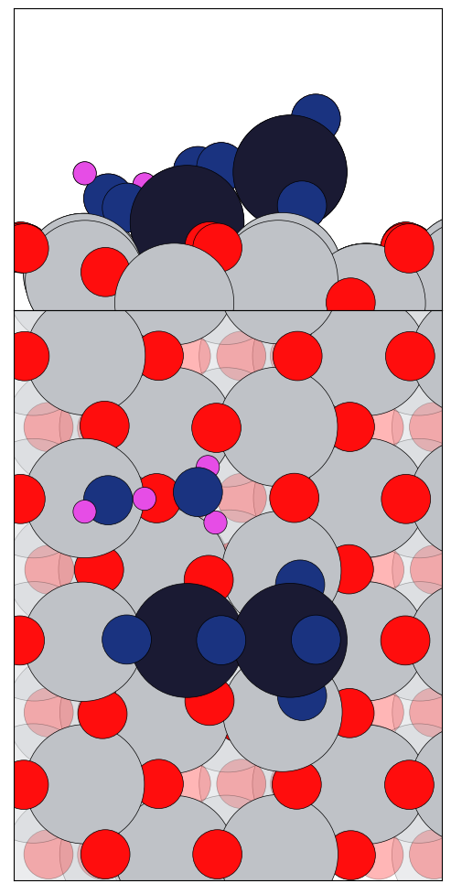
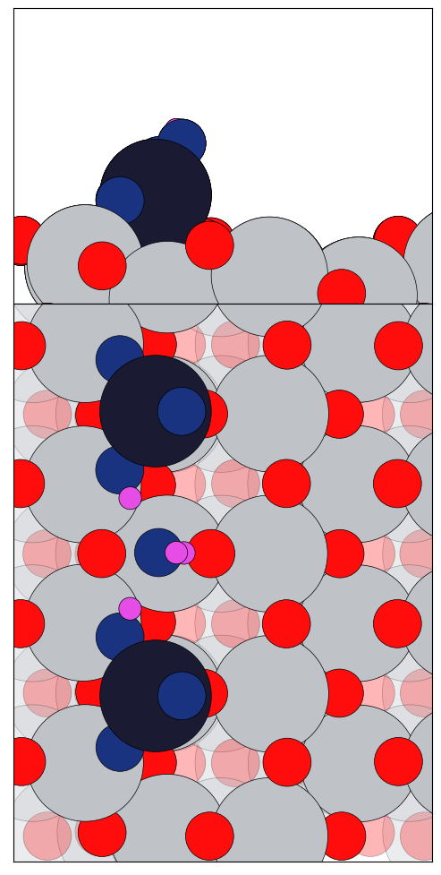
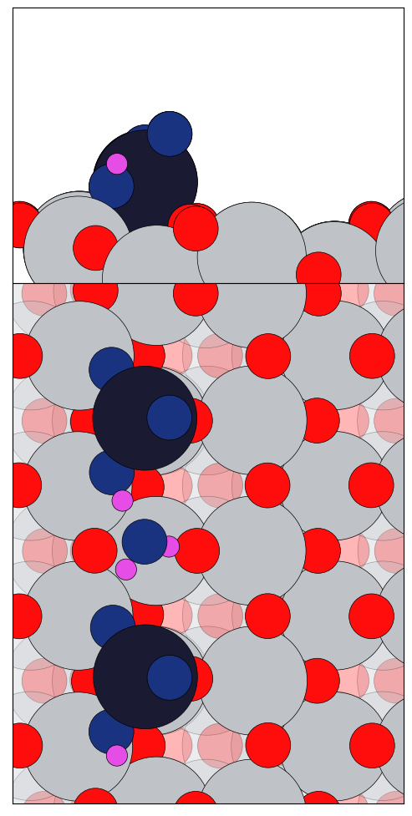
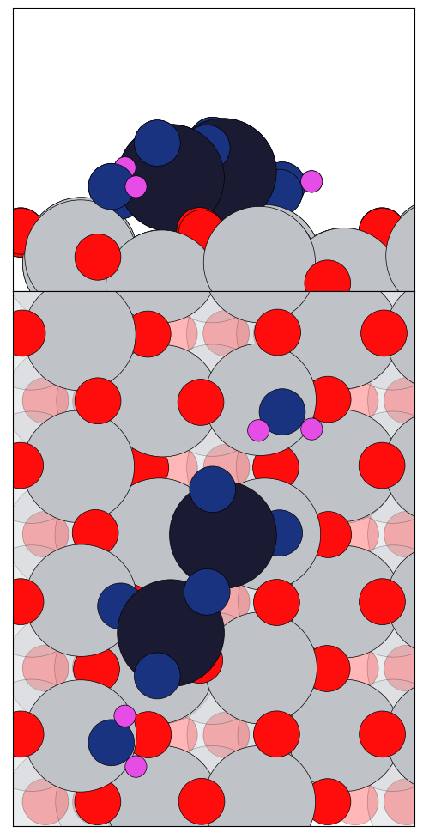
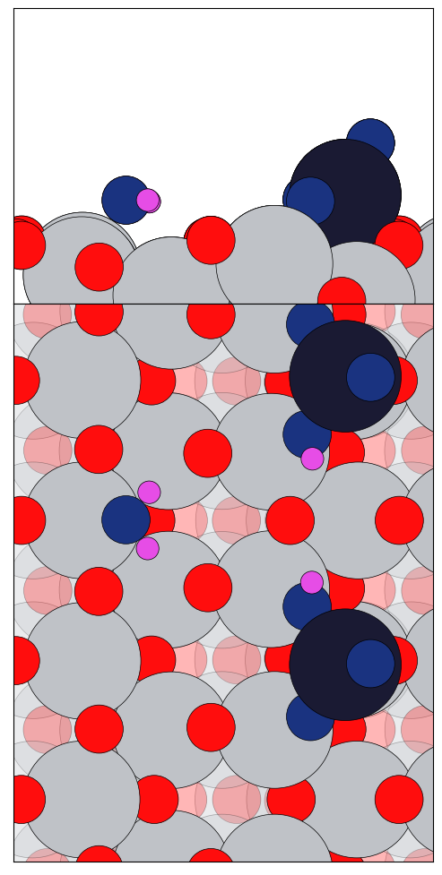
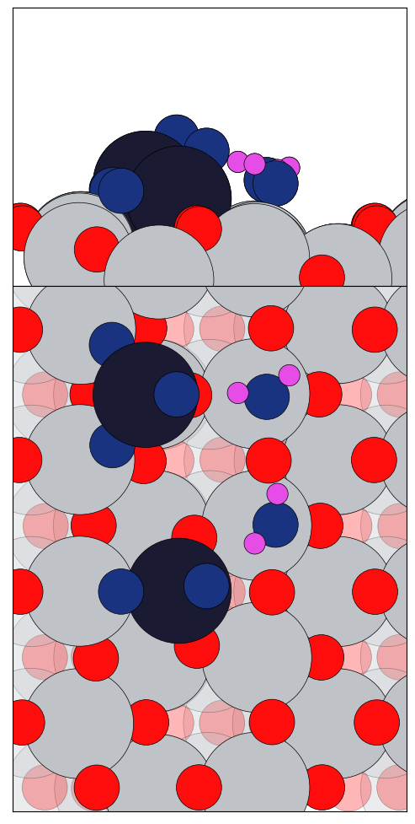
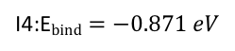
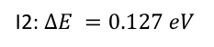
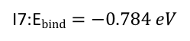
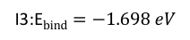
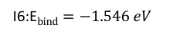
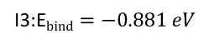
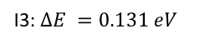
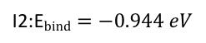
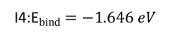
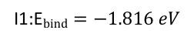
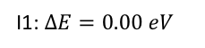
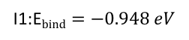
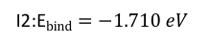
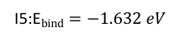
I2: $∆E =0.127 eV$
I3: $∆E =0.131 eV$
I1: $∆E=0.00 eV$
I7:E$bind=−0.784 eV$
I4:E$bind=−0.871 eV$
I3:E$bind=−0.881 eV$
I1:E$bind=−0.948 eV$
I2:E$bind=−0.944 eV$
I6:E$bind=−1.546 eV$
I2:E$bind=−1.710 eV$
I3:E$bind=−1.698 eV$
I4:E$bind=−1.646 eV$
I5:E$bind=−1.632 eV$
I1:E$bind=−1.816 eV$

Slide 2
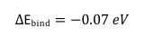
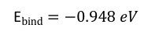
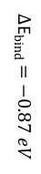
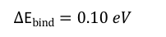
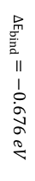
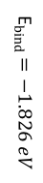
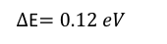
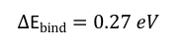
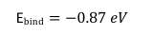
$∆$E$=0.12 eV$
GM
E$bind=−0.87 eV$
E$bind=−0.948 eV$
$∆$E$bind=−0.07 eV$
GM
$∆$E$bind=−0.676 eV$
$∆$E$bind=−0.87 eV$
E$bind=−1.826 eV$
$∆$E$bind=0.27 eV$
$∆$E$bind=0.10 eV$
GM

Slide 3
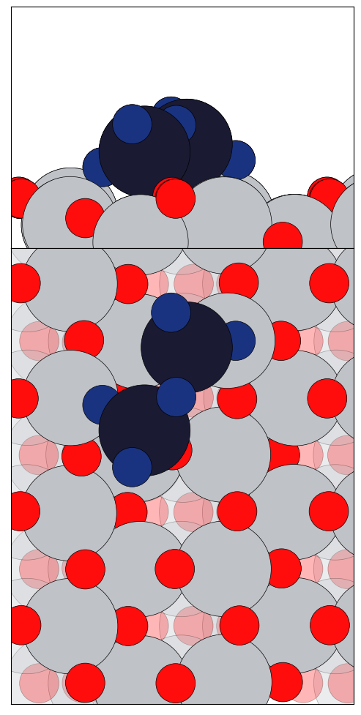
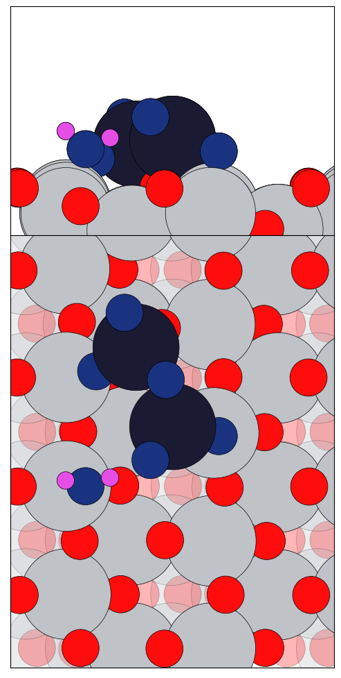
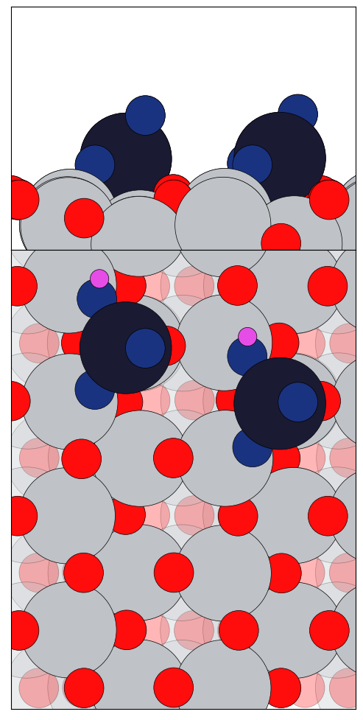
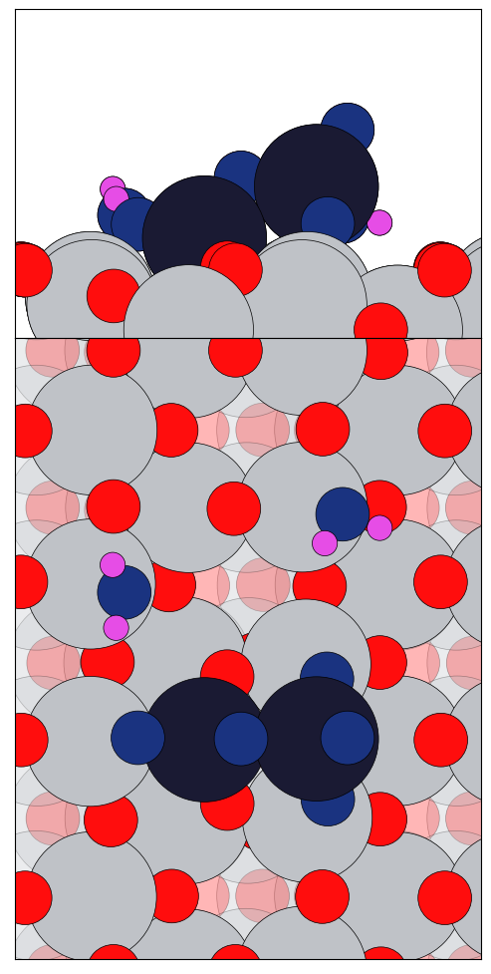
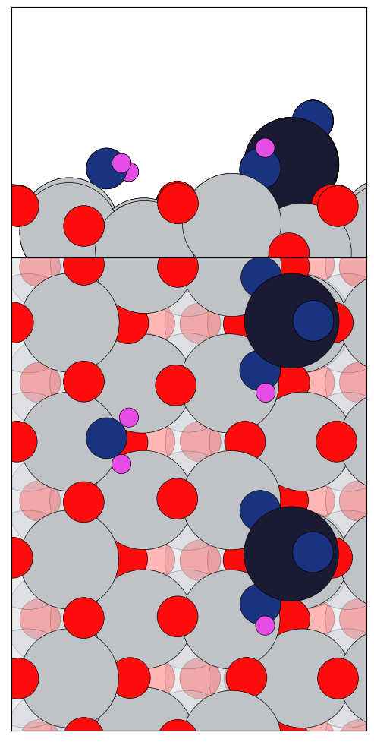
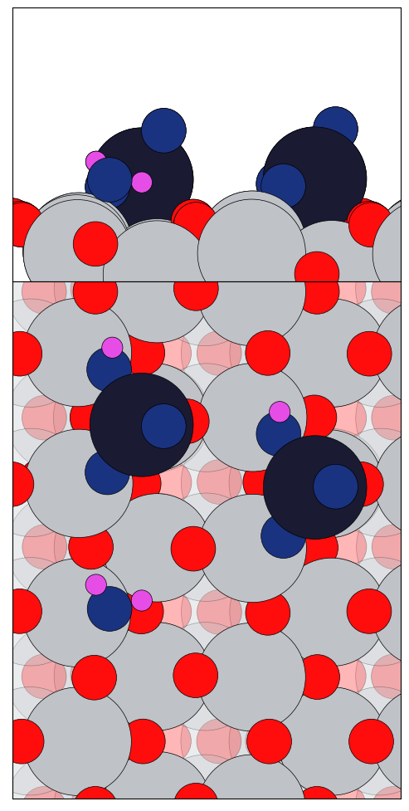
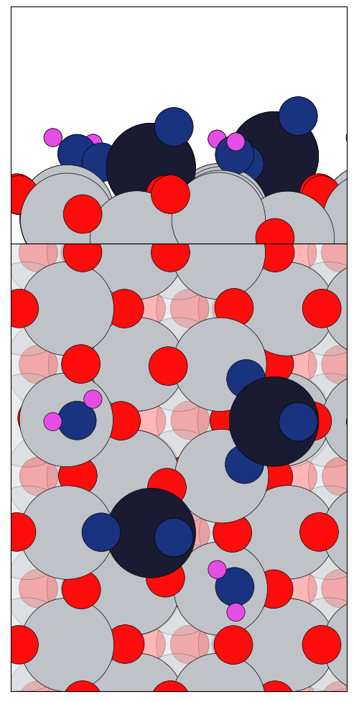
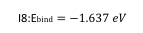
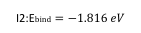
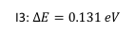
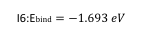
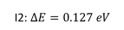
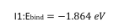











I4: $∆E=0.257 eV$
I2: $∆E=0.127 eV$
I3: $∆E=0.131 eV$
I1: $∆E=0.000 eV$
I5:E$bind=−0.780 eV$
I5:E$bind=−0.871 eV$
I3:E$bind=−0.944 eV$
I4:E$bind=−0.881 eV$
I1:E$bind=−0.950 eV$
I8:E$bind=−1.637 eV$
I7:E$bind=−1.646 eV$
I6:E$bind=−1.693 eV$
I4:E$bind=−1.709 eV$
I2:E$bind=−1.816 eV$
I5:E$bind=−1.698 eV$
I3:E$bind=−1.809 eV$
I1:E$bind=−1.864 eV$

Slide 4

















Binding Energy of V₂O₅ Clusters on Hydrolysis
$$0.257 eV$$
$$0.131 eV$$
$$0.127 eV$$
$$0.000 eV$$
$$-.780 eV$$
$$-.871 eV$$
$$-.881 eV$$
$$-.944 eV$$
$$-.948 eV$$
$$-.950 eV$$
$$I7= -1.637 eV$$
I6 = $-1.646 eV$
I5 = $-1.693 eV$
$$I4= -1.709 eV$$
$$I3= -1.809 eV$$
I2 = $-1.816 eV$
$$I1=-1.864 eV$$

Slide 5

Binding Energy of H₂O for V₂O₅+H₂O (O_{v}+csr)

Slide 6











Binding Energy of H₂O for V₂O₅+2 H₂O (O_{v}+csr)
I1:E$bind=−1.864 eV$
I1:E$bind=−1.816 eV$
I1:E$bind=−1.809 eV$
I2:E$bind=−1.710 eV$
I3:E$bind=−1.698 eV$
I3:E$bind=−1.693 eV$
I4:E$bind=−1.646 eV$
I6:E$bind=−1.637 eV$
I5:E$bind=−1.632 eV$
I7:E$bind=−1.438 eV$

Slide 8


